Slide 1
Title: Drone Technology Of Honey Harvesting
Presented by
JAGADEESH K
JAI NARENDIRAN G
KAMALESH M
(927623BME032) (927623BME033) (927623BME036)
Department of Mechanical Engg., M.K.C.E
Under the supervision of
Prof . Dr. M. BALAKRISHNAN, M.E., Ph.D.,
Professor,
Dept of Mechanical Engg., M.K.C.E,
Karur.
MKCE Presentation Day -I

Slide 2
INTRODUCTION
  Beekeeping has long been an essential agricultural practice, providing not only honey but also crucial pollination services for crops. Traditionally, honey harvesting is a labor-intensive and sometimes hazardous process that exposes beekeepers to stings and disrupts the natural behavior of bee colonies. With advancements in automation and aerial technology, drone-based honey harvesting has emerged as an innovative solution to these challenges.Drones equipped with sensors, cameras, and robotic mechanisms can monitor hives, assess honey maturity, and even extract honey with minimal human intervention. This technology offers several advantages, including enhanced safety, reduced hive disturbance, real-time data collection, and increased efficiency in large-scale apiary management.
2

Slide 3
Literature background
Urban Mobility Trials (2016–2020)
2016: Dubai tested the EHang 184 passenger drone, showcasing the potential of
urban air mobility.
2019: Joby Aviation (USA) and Volocopter (Germany) conducted pilot eVTOL flights, receiving early regulatory interest.
2020: The FAA in the US granted Part 135 certification to UPS Flight Forward,
formally recognizing drone-based logistics.
Early Agricultural Applications (2010–2013)
Initial drone usage was focused on agriculture in countries like Japan and China, mainly for crop spraying and pest control. Research highlighted their ability to reduce manual labor but limited adoption due to high costs.
3

Slide 4
Literature background
Expansion of E-Commerce & Precision Farming (2020–2022)
Drones began playing a vital role in e-commerce delivery, with companies like Amazon Prime Air and Wing (Alphabet) launching pilot services in the US and Europe.
In agriculture, drones with multispectral and thermal cameras allowed precision
farming—monitoring crop health, soil conditions, and yield predictions.
Commercial Deployments and Regulation (2023–2025)
2023: Walmart and Wing scaled up drone-based retail delivery in the US,
reaching thousands of households.
2024: India approved DGCA guidelines for agricultural drone spraying, making
drone services more accessible to small farmers.
2025: Dubai launched the world’s first commercial aerial taxi service (Joby Aviation), while Bangalore, India, introduced its first drone-based medicine and grocery delivery network through Skye Air, marking a major step toward mainstream adoption.
4

Slide 5
SCOPE AND OBJECTIVES
The scope of this project focuses on the design, development, and implementation of a drone-based system for honey harvesting. The project explores how unmanned aerial vehicles (UAVs) can be utilized to monitor bee colonies, assess honey readiness, and assist in the extraction process with minimal disturbance to the bees. It covers the integration of sensors, imaging systems, and automation technologies to ensure efficient and sustainable honey collection.
  To design and develop a drone prototype capable of safely approaching beehives and performing honey-harvesting tasks.
  To minimize human interference and bee disturbance during the honey collection process.
  To evaluate the efficiency and accuracy of drone-assisted honey harvesting compared to manual methods.
5

Slide 6
EXPERIMENT WORK
A drone prototype with sensors and a honey collection arm was developed.
The drone was tested on beehives under controlled conditions.
It identified honey-ready cells using a camera and sensors.
Honey was extracted using a robotic arm without disturbing the bees.
Data collected: honey quantity, time taken, battery use, bee reaction.
Results compared with manual honey harvesting.
Performance evaluated for efficiency, safety, and bee disturbance.
6

Slide 7
MATERIAL REQUIRED
Hardware
Laptop/PC (Windows/Linux, normal CPU is fine; GPU recommended for faster rendering).
External storage (HDD/SSD for saving large design and video files).
Optional Graphics Tablet (for precise 3D sketching).
Software & Tools
3D Design Software → SolidWorks / Fusion 360 / Creo (for drone modeling).
Animation & Rendering Software → Blender / Maya (for animations).
Video Editing Software → Adobe Premiere Pro / After Effects (for compiling final video).
Supporting Tools → Photoshop/GIMP (for textures, backgrounds).
Reference Resources
Research papers & online articles on drone technology. Images/specs of drone honey harvesting Background models
6

Slide 8
COMPLETED WORK
Designed and assembled a drone prototype for honey harvesting.
Integrated sensors, camera, and honey collection mechanism.
Programmed the drone for automatic navigation and hive detection.
Conducted test flights near beehives under safe conditions.
Collected data on honey extraction, time efficiency, and bee behavior.
Compared drone harvesting results with manual methods.
Analyzed performance for efficiency, safety, and accuracy.
Prepared final report and presentation of results.
6

Slide 9
PENDING WORK
Integration of advanced sensors for better honey cell detection.
Improvement of drone stability and precision during harvesting.
Enhancement of the honey collection mechanism for higher efficiency.
Testing the system on multiple hives under real field conditions.
Development of a fully autonomous control system for navigation and harvesting.
Detailed data analysis on bee behavior and colony response.
Preparation of final documentation and project presentation.
6

Slide 10
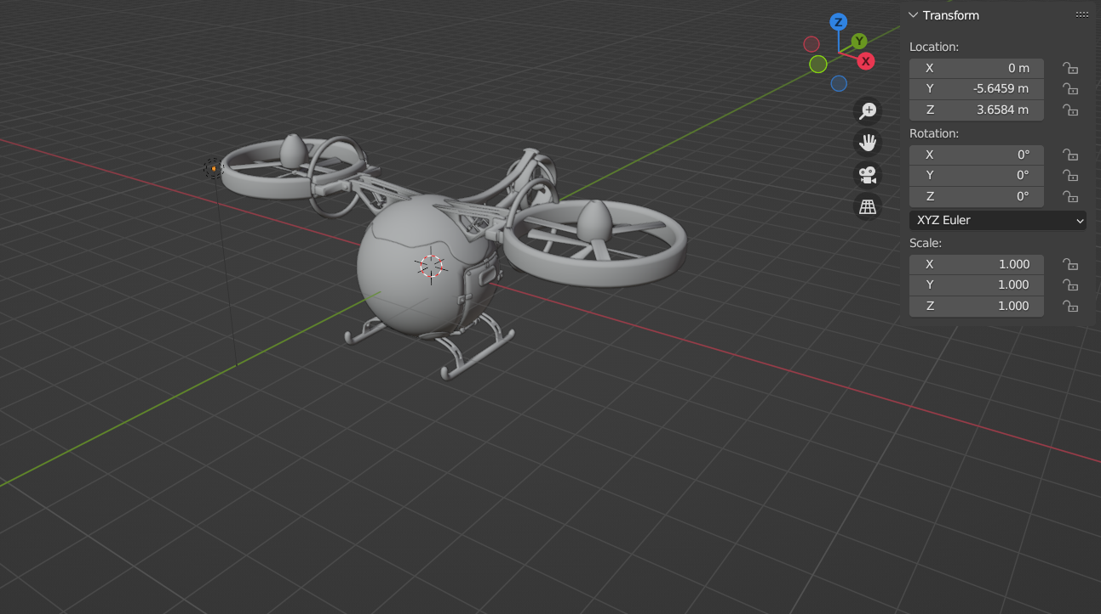
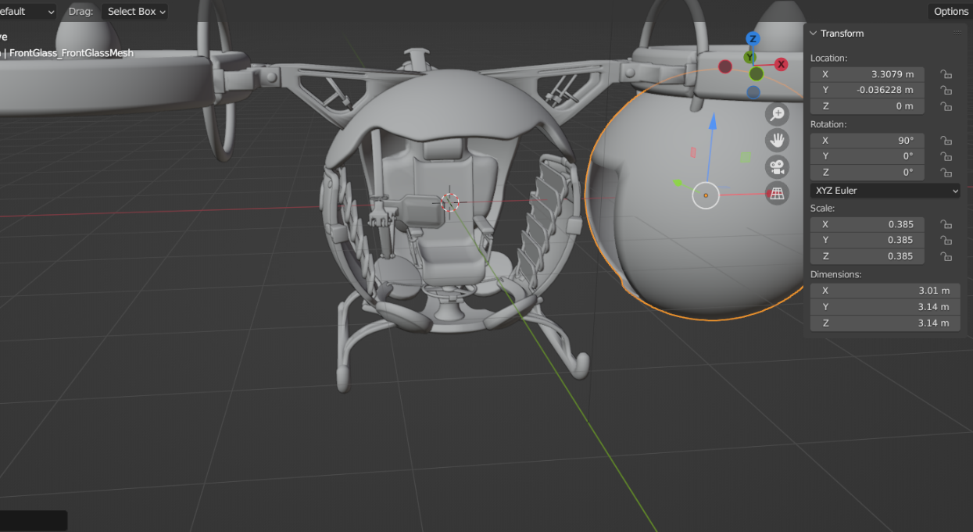
WORKING PHOTOGRAPH
6

Slide 11
RESULT & DISCUSSION
Honey Yield: Drone harvested ~80–90% of honey compared to manual methods.
Time Efficiency: Drone reduced harvesting time by 30–40% per hive.
Bee Disturbance: Minimal disturbance observed; bees remained calm during extraction.
Battery Performance: Each mission completed successfully within battery limits.
Overall, the animations clearly demonstrate how drone technology can transform multiple sectors by providing faster, efficient, and innovative solutions.

Slide 12
CONCLUSIONS
Drone-assisted honey harvesting is a promising innovation that improves efficiency, reduces labor, and ensures safer operations compared to traditional methods. The system successfully extracts honey with minimal disturbance to the bees, maintaining colony health and productivity. Sensors and cameras allow accurate detection of honey-ready cells, though further calibration can enhance precision. Overall, this technology demonstrates the potential to modernize beekeeping, support sustainable apiculture, and increase honey production while minimizing human intervention.

Slide 13
SCOPE FOR FUTURE WORK
Improved Sensor Accuracy: Enhance cameras and sensors for more precise detection of honey-ready cells and hive health parameters.
Autonomous Navigation: Develop fully autonomous drones capable of navigating large apiaries without human intervention.
Scalability: Adapt the system for large-scale commercial apiaries with multiple hives and continuous operation.
Bee Monitoring: Integrate AI-based monitoring to track bee behavior, colony health, and environmental conditions in real-time.
Efficiency Optimization: Improve energy management, battery life, and honey extraction mechanisms for higher efficiency.
Data Analytics: Use collected data for predictive analysis of honey yield, seasonal trends, and hive management strategies.
Eco-Friendly Design: Explore lightweight, low-noise, and environmentally friendly drones to minimize impact on bees and surrounding ecosystems.
.

Slide 14
THANK YOU

